Slide 1
MLDS HW3-1
TAs
ntu.mldsta@gmail.com

Slide 2
Update
5/8 : 更新Baseline Model

Slide 3
Baseline Model (⅝ Update)
Generator
input = (100, )
Dense(128*16*16, ‘relu’)
Reshape((16, 16, 128))
Upsampling
Conv2D(128, kernel = 4)
Relu
Upsampling
Conv2D(64, kernel = 4)
Relu
Conv2D(3, kernel = 4)
tanh
Training
Adam(lr = 0.0002, beta = 0.5)
Discriminator
input = (64, 64, 3)
Conv2D(32, kernel = 4)
Relu
Conv2D(64, kernel = 4)
ZeroPadding
Relu
Conv2D(128, kernel = 4)
Relu
Conv2D(256, kernel = 4)
Relu
Flatten
Dense(1, sigmoid)

Slide 4
Outline
Timeline
Task Descriptions
Model & Training tips
Submission & Rules
Q&A

Slide 5
Timeline

Slide 6
Three Parts in HW3
(3-1) Image Generation
(3-2) Text-to-Image Generation
(3-3) Style Transfer

Slide 7
Schedule
5/4 :
Release HW3-1
5/11 :
Release HW3-2
5/18:
Release HW3-3
6/8:
All HW3 due (including HW3-1, HW3-2, HW3-3)
上台分享

Slide 8
Task Descriptions

Slide 9
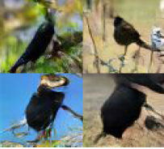
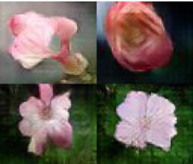
HW3-1: Image Generation 2/2
Bird
Generative Model
Flower Generative Model

Slide 10
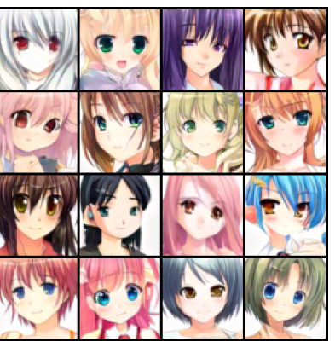
HW3-1: Image Generation 2/2
Anime
Generative Model

Slide 11
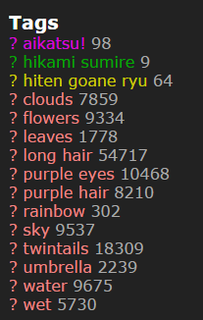
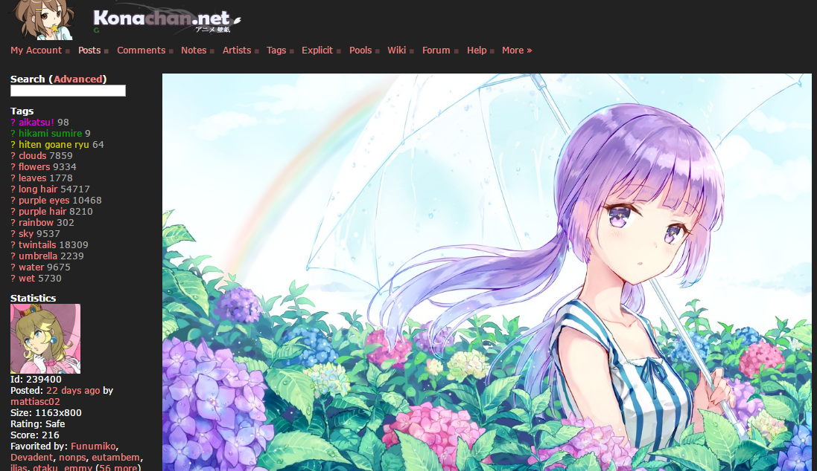
Data Collections 1/2
Anime dataset
http://konachan.net/post/show/239400/aikatsu-clouds-flowers-hikami_sumire-hiten_goane_r
感謝樊恩宇助教蒐集data

Slide 12
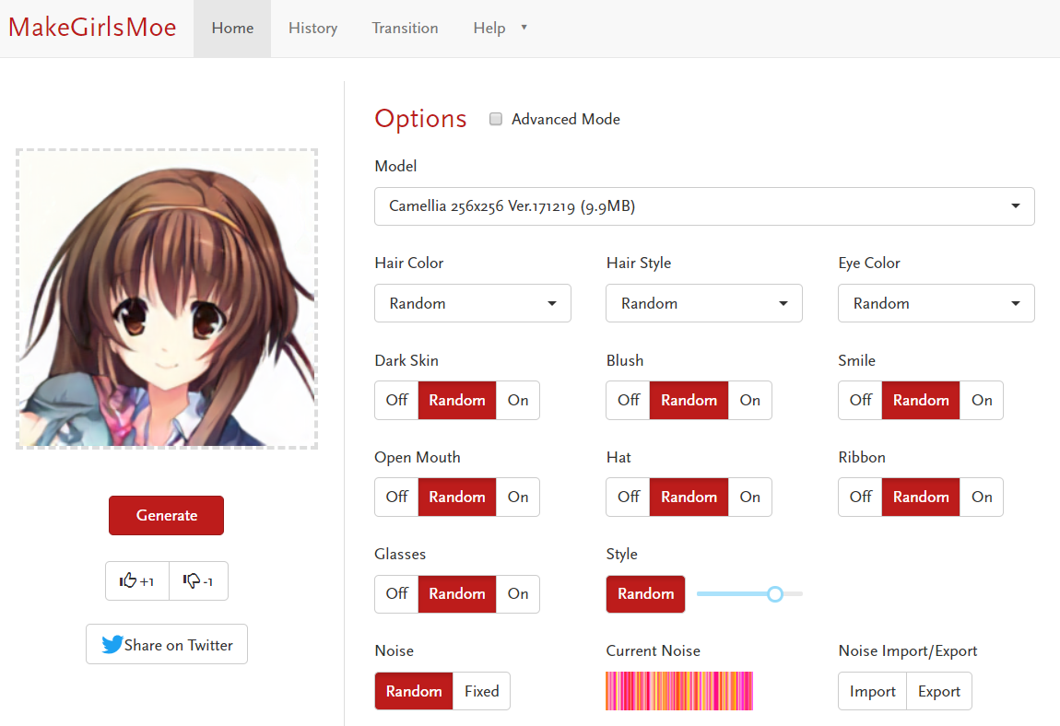
Data Collections 2/2
Extra data
https://make.girls.moe/#/
感謝吳宗翰同學收集並處理資料

Slide 13
Model & Training Tips

Slide 14
GAN 1/5
Overview
real images
Discriminator
fake
images
noise
Generator

Slide 15
GAN 2/5
Discriminator
input: images (batch_size, height, width, channels)
output: scores (batch_size,)
arthitecture: CNN, DNN
Generator
input: noises (batch_size, noise_dim)
output: images (batch_size, height, width, channels)
arthitecture: CNN, DNN
use deconvolution (transpose convolution) layer in CNN

Slide 16
GAN 3/5
Training procedure
repeat max_iteration times
repeat d_update times
discriminator = update_discriminator(training_data, generator)
repeat g_update times
generator = update_generator(discriminator)
Testing procedure
noise = sample_batch_noise(batch_size, noise_dim)
output_images = generator(noise)

Slide 17
GAN 4/5
Update discriminator
real_images = sample_batch_data(training_data, batch_size)
noise = sample_batch_noise(batch_size, noise_dim)
fake_images = generator(noise)
real_predicts = discriminator(real_images)
fake_predicts = discriminator(fake_images)
d_loss = loss_d_fn(real_predicts, real_labels, fake_predicts, fake_labels)
d_grad = gradients(d_loss, d_params)
d_params = updates(d_params, d_grad)
# do not update the parameters of generator

Slide 18
GAN 5/5
Update Generator
noise = sample_batch_noise(noise_dim, batch_size)
fake_images = generator(noise)
fake_predicts = discriminator(fake_images)
g_loss = loss_g_fn( fake_predicts, real_labels )
g_grad = gradients(g_loss, g_params)
g_params = updates(g_params, g_grad)
# do not update the parameters of discriminator

Slide 19
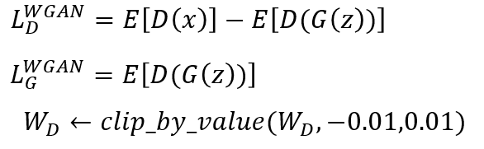
Wasserstein GAN 1/3
The output of D is thus not probability anymore.
The D loss turn to be a measure of distance.
ref:https://arxiv.org/abs/1701.07875

Slide 20
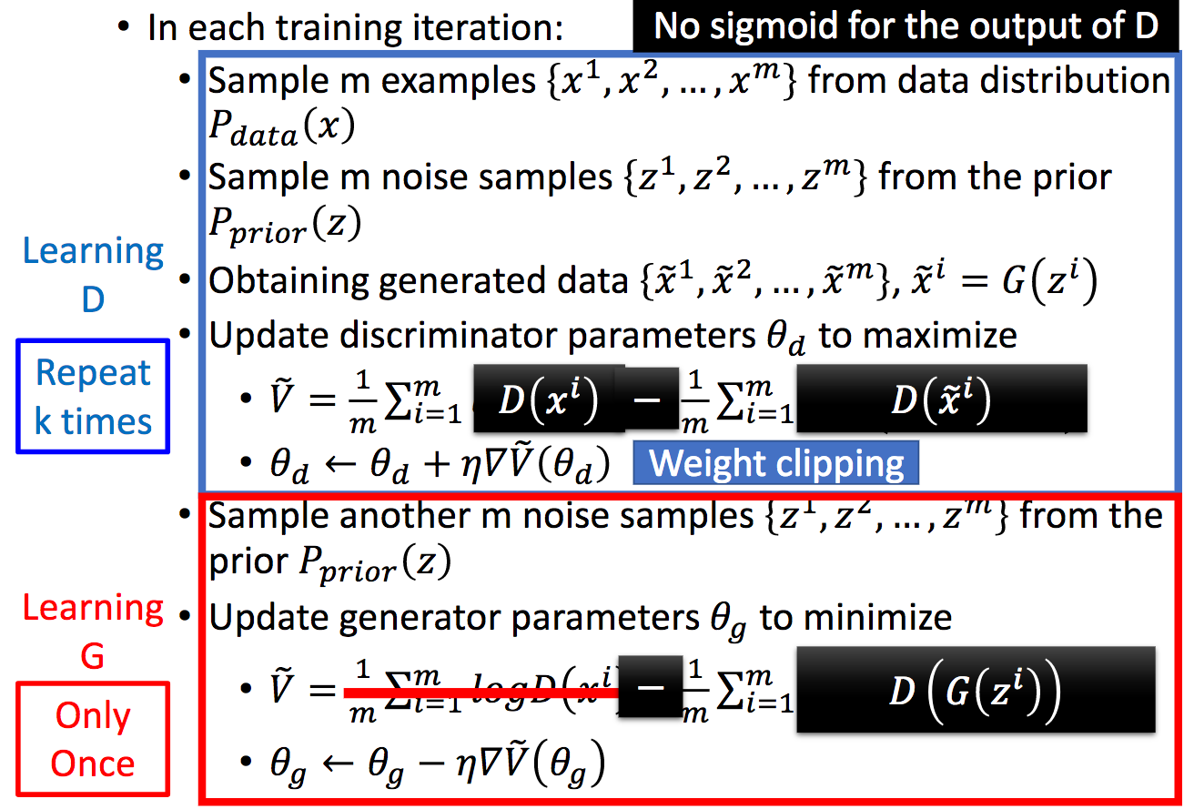
Wasserstein GAN 2/3

Slide 21
Wasserstein GAN 3/3
Implementation Notes:
Do not apply sigmoid at the output of D
Clip the weight of D
Use RMSProp instead of Adam
Train more iteration of D (the paper use 5)

Slide 22
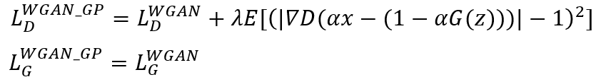
Improved WGAN (WGAN-GP) 1/2
Do not clip the weight of D but to add a new objective called “Gradient Penalty”.
ref:https://arxiv.org/pdf/1704.00028.pdf

Slide 23
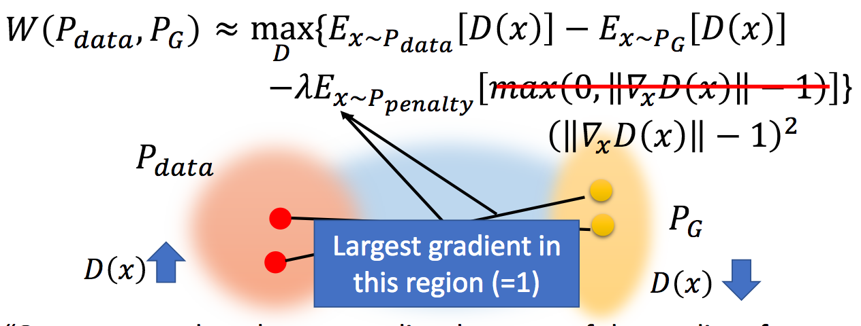
Improved WGAN (WGAN-GP) 2/2
ref:https://arxiv.org/pdf/1704.00028.pdf

Slide 24
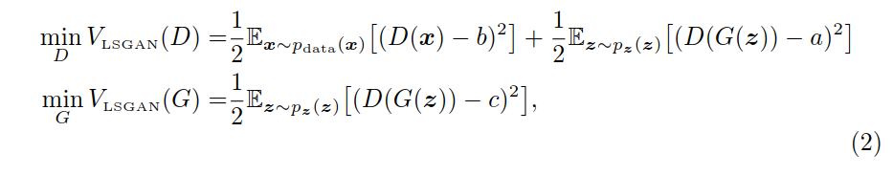
Least Squares GAN
1
1
0
-1
1
0
ref:https://arxiv.org/abs/1611.04076

Slide 25
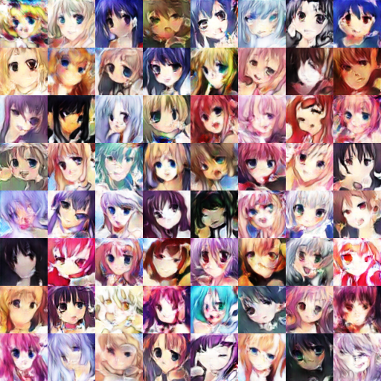
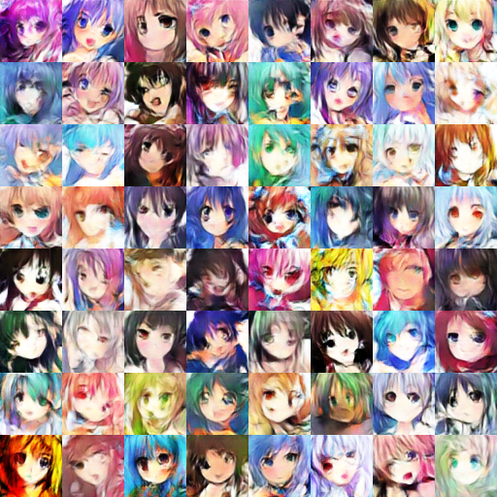
Little Results
GAN result
WGAN result

Slide 26
Submission & Grading

Slide 27

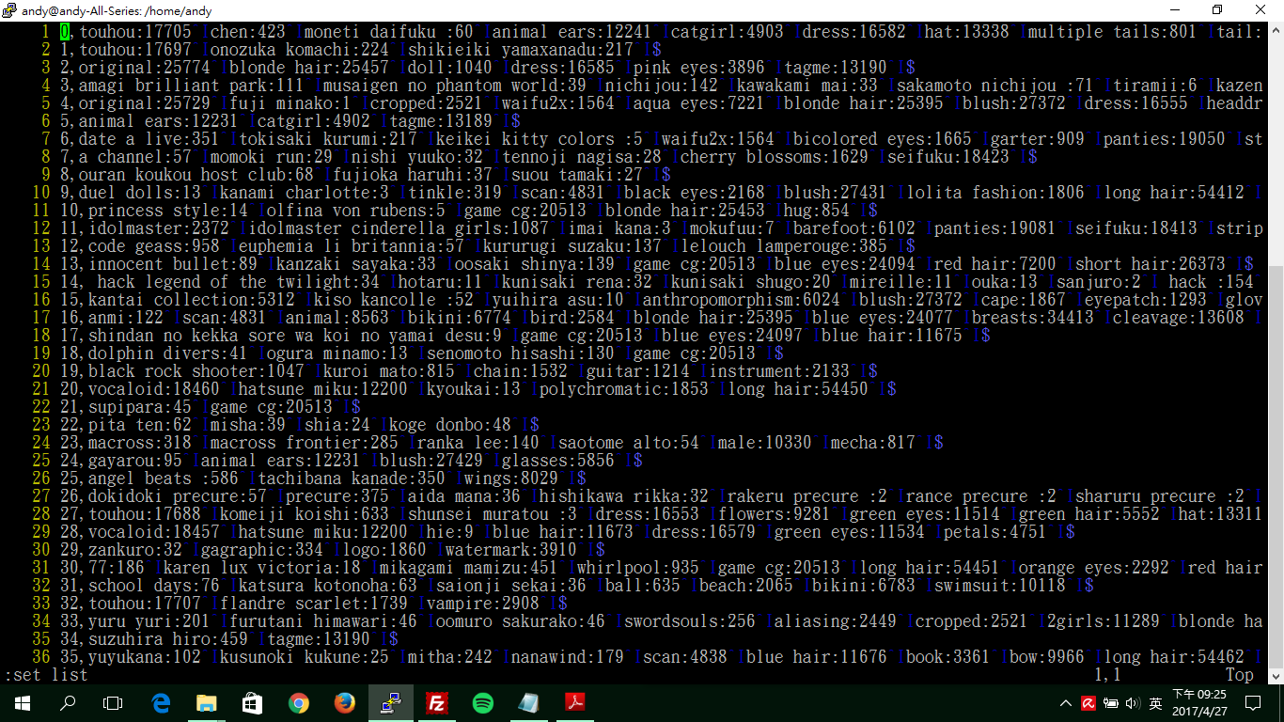
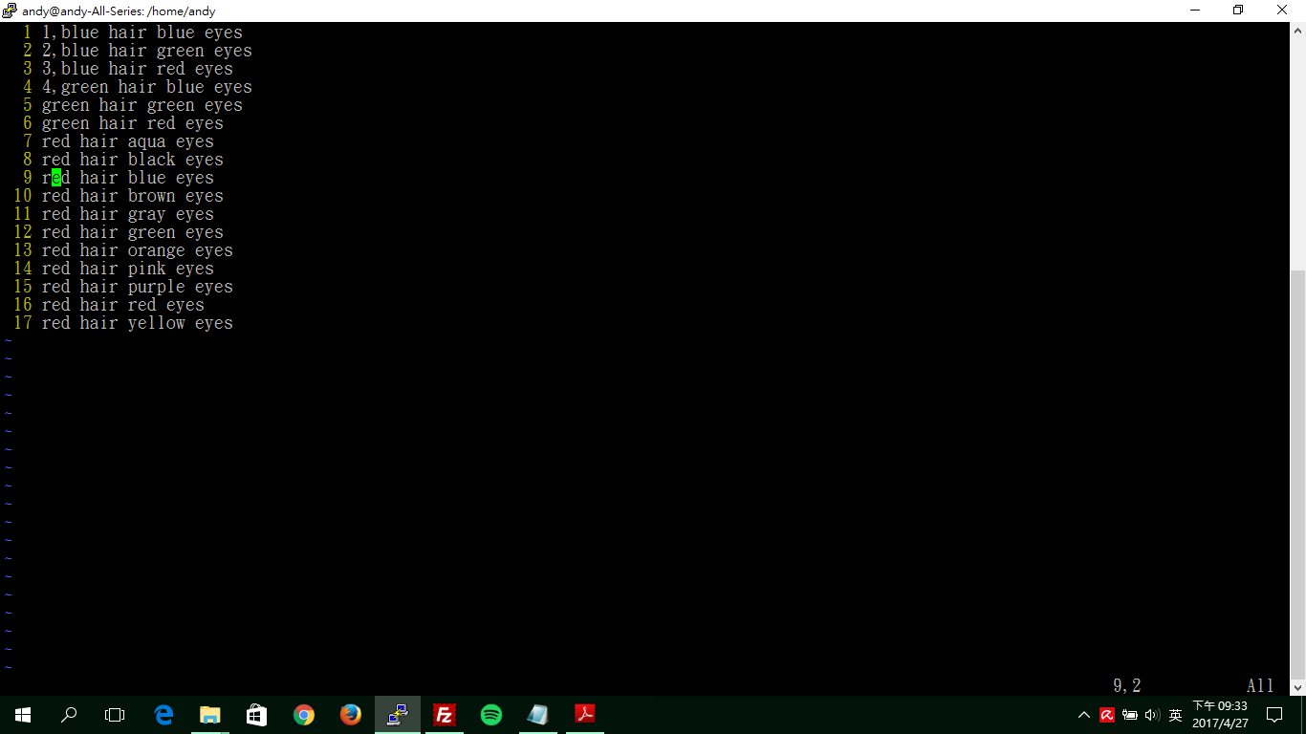
Data & format
Anime Dataset
training data: 33.4k (image, tags) pair
faces/, tags.csv, sample_testing_text.txt
training tags file format
img_id <comma> tag1 <colon> #_post <tab> tag2 <colon> #_post
tags.csv is not used in HW3-1
testing text file format
testing_text_id <comma> testing_text
testing text only includes ‘color hair’ and ‘color eyes’, only alphabetic char involved.
sample_testing_text.txt is not used in HW3-1
blue eyes
red hair
short hair
tags.csv
sample testing_text.txt

Slide 28

Data & format
Extra data
training data: 36.7k (image, tags) pair
images/, tags.csv
training tags file format
img_id <comma> hair tag <space> eyes tag
tags in extra data only includes ‘color hair’ and ‘color eyes’
tags.csv is not used in HW3-1
black eyes
red hair
tags.csv

Slide 29
Data Link
Anime Dataset
Extra Data

Slide 30
HW3 Grading Policy:
HW3-1 Code (image generation) : 5%
HW3-2 Code (text-to-image generation): 5%
Report : 15%
HW3-3 (Bonus, style transfer): 2%
分工表：0.5%
上台分享 : 1%
上台分享前三名：1%

Slide 31
HW3 Report Questions
Model Description
Describe the models you use to, including the model architecture, objective function for G and D.
Image Generation (2%)
Text-to-image Generation (2%)
Experiment settings and observation
Show generated images
Image Generation (1%)
Text-to-image Generation (1%)
Compare your model with WGAN, WGAN-GP, LSGAN (choose 1) (Image Generation Only)
Model Description of the choosed model (1%)
Result of the model (1%)
Comparison Analysis (1%)
Training tips for improvement (Image generation Only) (6%)

Slide 32
Training Tips for improvement
Pick three tips in the following website
https://github.com/soumith/ganhacks
Please implement these tips on image generation
Total : 6%, 2% for each
Which tip & implement details (1%)
Result (image or loss...etc.) and Analysis (1%)
Only the following tips are accepted
1, 2, 3, 4, 5, 6, 9, 13, 14, 17

Slide 33
HW3-1 Code Grading
Reproduce Score : 2%
Baseline Scroe : 2%
TA Review : 1% (mode collapse)

Slide 34
Output Format Requirement
The generated images should be in Directory samples/
請大家繳交時就將產生的結果傳到samples/，助教利用script reproduce時也請同學將結果輸出到這個資料夾。為保證reproduce結果相同，請同學將random的部份固定
批改作業會在azure上，請同學繳交前在機台上檢查
已經在github裡的image -> samples/gan_original.png
run_gan.sh -> samples/gan.png
Each generated image must be resized to 64 x 64
Generate 25 image into one png
sample code is in baseline.py
為防止同學產生的圖片不一致，請同學使用baseline.py裡的save_imgs()

Slide 35
Baseline Model
Anime Face Recognition
Github for baseline.py
How to run:
pip install opencv-python
Download pre-trained model in Here.
python baseline.py --input <input_image>
Generate 25 images in one png
if faces > 20: pass
下週二(5/8)會釋出最簡單架構

Slide 36
Allow Packages
Python 3.6
Tensorflow r.16 ONLY (CUDA 9.0)
PyTorch 0.3 / torchvision (0.4 is not allowed)
Keras 2.0.7 (Tensorflow backend only)
MXNet 1.1.0
CNTK 2.4
matplotlib
skimage
numpy, scipy
Python Standard Library
If you want to use other packages, please ask TAs for permission first!
new allowed package: pandas, tensorlayer, gensim, nltk

Slide 37
Submission on Github
Only one branch master is needed
Only generator and inference mode is needed
Remember to put your pre-trained models or download scripts so that we can run your code successfully

Slide 38
Submission
Deadline: 2018/06/08 GMT+8 24:00
hw3/ should contain the following files:
run_gan.sh (hw3-1)
run_cgan.sh (hw3-2)
extra_run.sh (hw3-3, bonus)
samples/, samples/gan_original.png
report.pdf
pre-trained model, python code...
If some files are too big, upload to your cloud and download them when running your run.sh
TAs will run your scripts in the following order to generate images
bash run_gan.sh (hw3-1)
All scripts must output in 10 minutes.
shell script裡面請寫相對路徑
HW3-2, 3-3格式會在之後釋出

Slide 39
Q&A
ntu.mldsta@gmail.com

